Slide 1
AMST 140 Washington: Life inside a Monument
Week 10: Neighborhood Change and Displacement

Slide 2
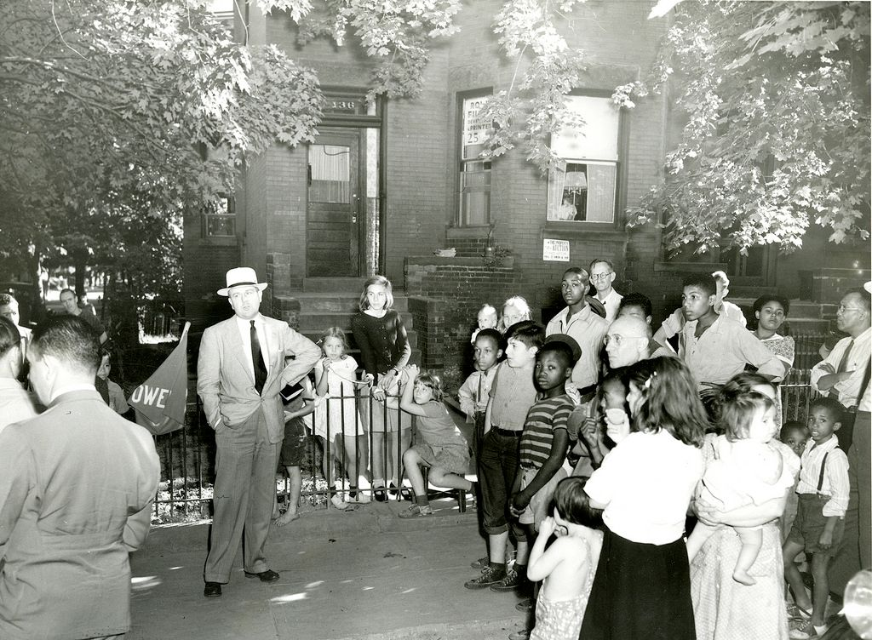
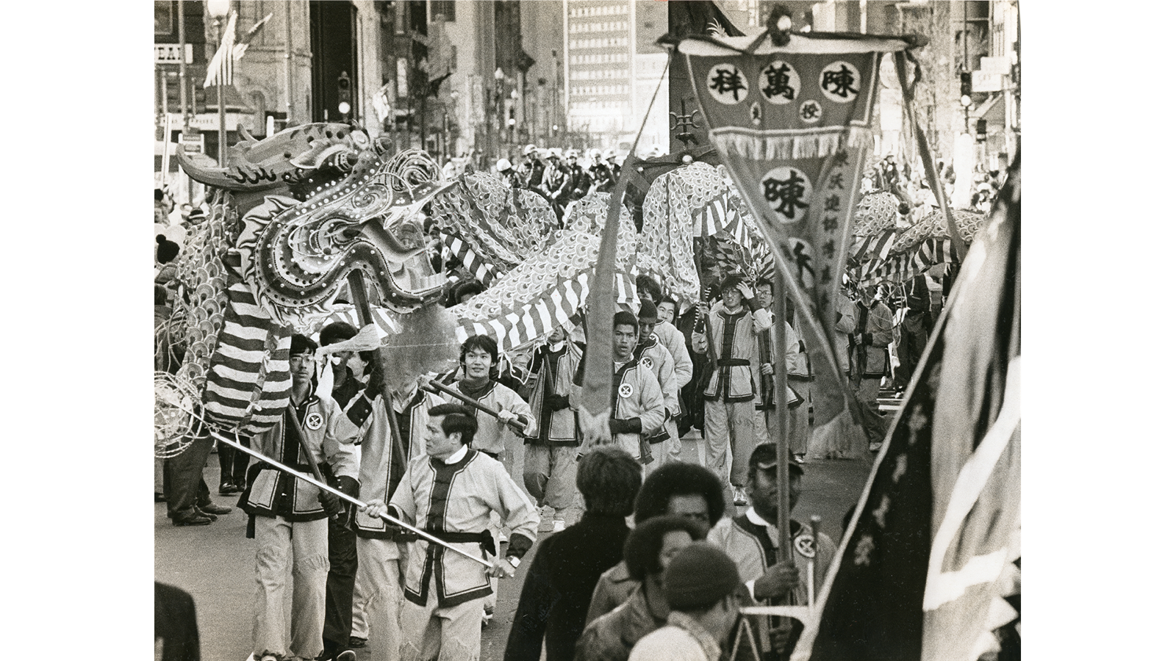
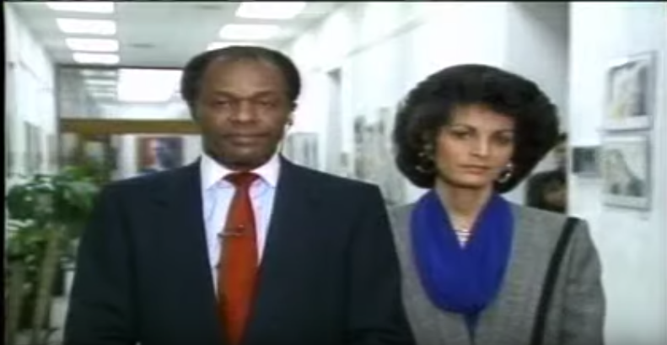
Actions of Individuals and Groups Matter
Notes:
Photo Sources:
https://storymaps.arcgis.com/stories/1ecaad7fe8cb4c4cb87c91e78deb427d
https://www.arcgis.com/apps/MapJournal/index.html?appid=58c3e00881374a7b8acddade025ade64
Nine Lives of Marion Barry. Film.

Slide 3
A Refresher: Gentrification
The processes by which:
Higher income or higher status people relocate to or invest in low income, urban neighborhoods.
These neighborhoods have been historically disinvested by both the public and private sectors
So as higher income people move to these areas, it’s typically to capitalize on the low property values
In doing so they:
inflate property values
displace low income people
fundamentally alter the culture and character of neighborhood
https://youtu.be/XqogaDX48nI
Notes:
Source: TedTalk by Prof. Stacey Sutton of Columbia University

Slide 4
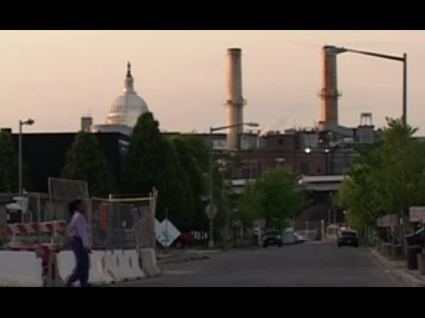
Finish the Remainder of Film: Chocolate City
Start Play at: 19:13 https://youtu.be/P1NkfATQvj4?t=1153

Slide 5
Film: Chocolate City
For your own notes please record the following answers:
How did residents talk about their losses?
How does anti-immigrant sentiment reveal itself in the film? What role might gentrification play in this anti-immigrant sentiment?
Chocolate City tells the story of gentrification and displacement primarily through the voices of Anu Yadav and Debra Frazier, though hundreds of Black residents lived in this community these women spoke this story. Why do you think that is? What might it say about race, class, and voice on the issue of gentrification?

Slide 6
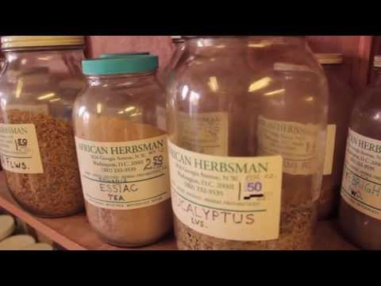
Pan African Washington, D.C.
For your notes:
1) What purposes does the shop serve for the community?
2) How is community expressed in the space?

Slide 7
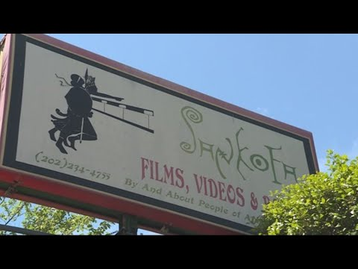
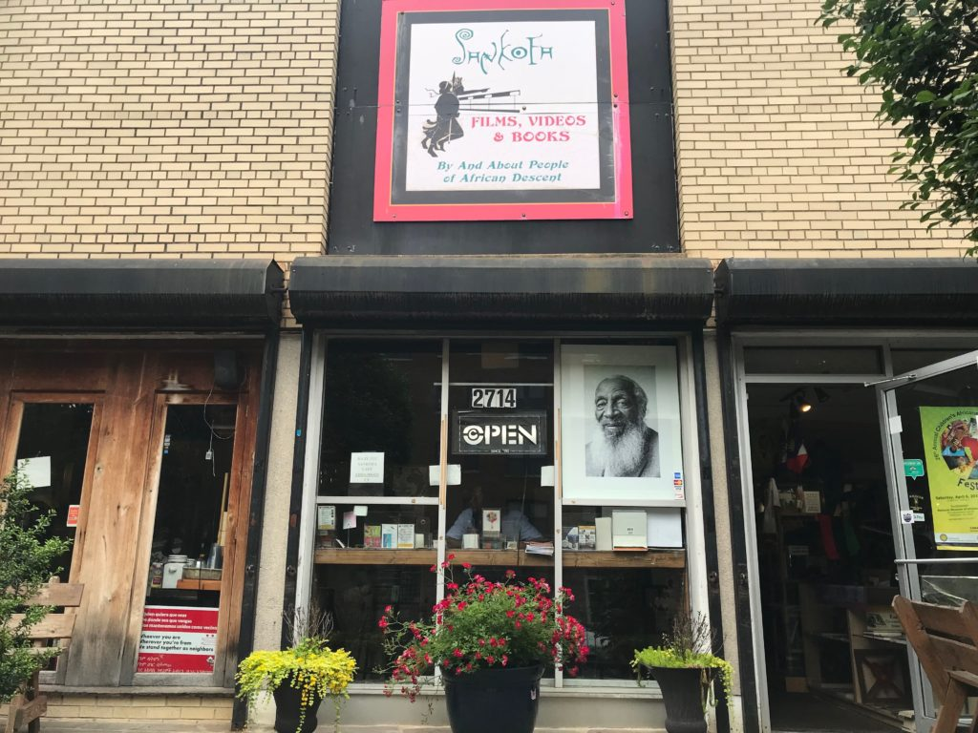
Sankofa Bookstore: A Community Space
Click here to read more: https://dcist.com/story/19/05/29/in-increasingly-expensive-d-c-a-longtime-black-bookstore-looks-for-tax-relief/

Slide 8
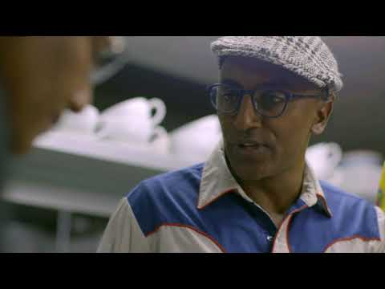
Little Ethiopia, Little Eritrea
Click this link to hear the WAMU Podcast on how DC’s Ethiopian and Eritrean community developed in Washington, DC:
https://wamu.org/story/16/04/21/how_did_the_dc_region_become_home_to_the_largest_population_of_ethiopians_in_the_us/
Notes:
Photo source: http://www.tadias.com/06/11/2013/little-ethiopia-african-diaspora-who-call-us-capital-home-bbc-video/

Slide 9
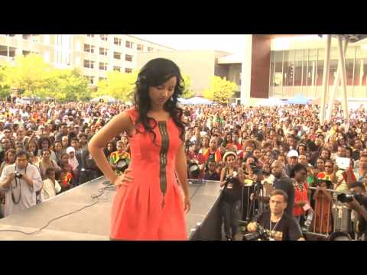
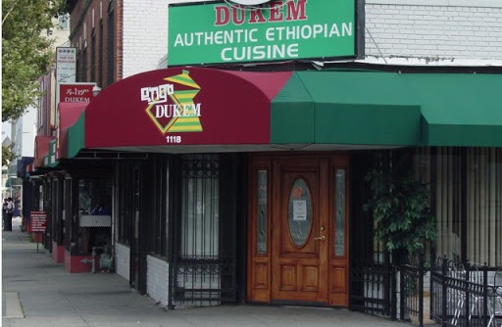
Community Change and Effects
The Old Community in Washington, DC
The New Community in Silver Spring, Maryland
Notes:
Photo credit: http://www.tadias.com/06/11/2013/little-ethiopia-african-diaspora-who-call-us-capital-home-bbc-video/

